Slide 1
Facilities for optimising and designing multi-arm multi-stage (MAMS) randomised controlled trials with binary outcomes
Babak Choodari-Oskooei
Daniel Bratton, Mahesh KB Parmar
MRC Clinical Trials Unit at UCL
Institute of Clinical Trials & Methodology, University College London
7-8 September 2023

Slide 2
Outline
Introduction to MAMS designs
Example: Surgical wound infection trial
Optimal and efficient MAMS designs
nstagebinopt and nstagebin commands
Summary

Slide 3



Multi-Arm Multi-Stage (MAMS) designs
Methods by Royston et al. (2003)
For time-to-event outcomes
Context: Randomised clinical trials
Efficacy and safety of new interventions in a defined population
Control of operating characteristics are important
Probability of false positive (Type I error)
Of interest to regulators and reviewers
Probability of true positive (Power)
Of interest to funders
Multiple research arms vs a common control arm
MAMS design has many advantages and challenges
Control
E1
E2
E3
E4
E5
Stage 1
Stage 2
Stage 3
Notes:
- Now we focus in on the particular class of MAMS design under consideration
- Methods for a multi-arm 2-stage design were developed in the early 2000s and later extended to the multi-stage setting
- Developed for time-to-event outcomes with applications in cancer trials
- Later extended to trials with binary outcomes
- Targets late phase/confirmatory trials – most costly phase of testing
- Makes pairwise comparisons between multiple research arms and 1 common control arm – no direct head to head comparisons of research arms
- Permits the use of an intermediate outcome measure which is correlated with definitive/primary outcome but can be observed earlier to allow trigger interim analyses early on in trial
- This int/I-outcome could be composite including primary outcome e.g. FFS/PFS an intermediate outcome for OS
- Early interim analyses allow us to drop arms mid-trial if they do not demonstrate sufficient benefit against the control arm (LOB assessment)
- Such a design is denoted $I≠D$ to indicate the intermediate outcome differs from the definitive outcome
- I=D correspondingly denotes a design in which the same outcome measure is used throughout

Slide 4
Introducing a randomised MAMS trial in
surgical wound infection

Slide 5
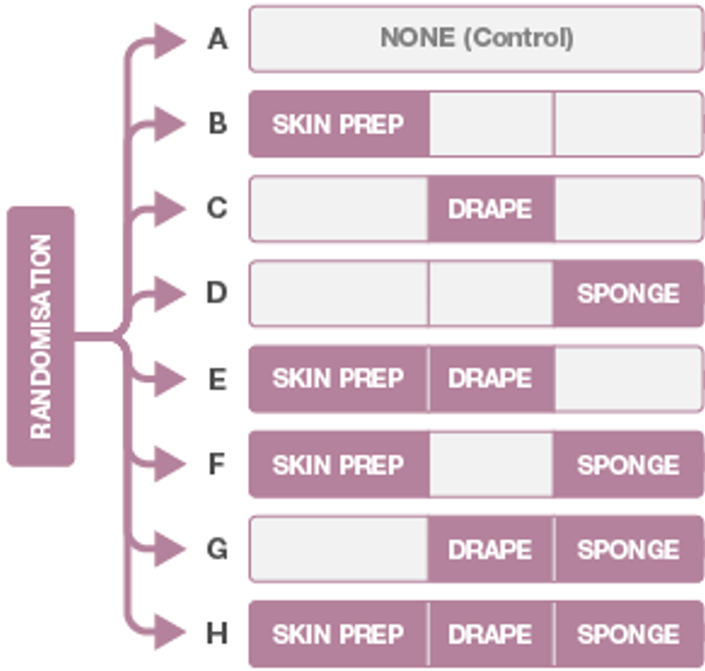
Example – the ROSSINI 2 surgical trial
8-arm 3-stage trial in surgery
i.e. 7 pairwise comparisons
The overall type I error rate across all comparisons and stages (FWER) is controlled at 2.5% (one-sided)
Overall pairwise power is controlled at 85%, i.e. for each
pairwise comparison of research arm against control
Clinical outcome composite binary,
Surgical site infection (SSI) within 4 weeks
Same outcome used in all stages
Target an effect size of 5% reduction from control arm risk of 15%
5

Slide 6

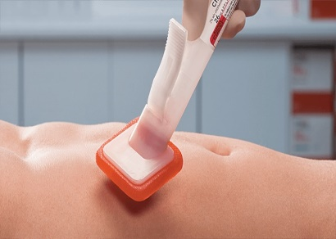
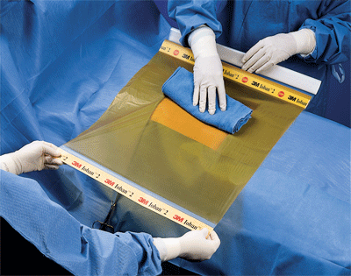
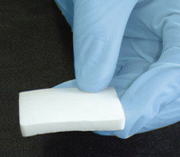
Example – the surgical trial
8-arm 3-stage surgical trial
Clinical outcome: composite binary, surgical site infection (SSI);
Main interventions
A) Chlorhexidine 2% alcoholic skin prep [versus any other standard wound prep agent of surgeon’s choice]
B) Loban-impregnated incise drapes [versus no drape]
C] Gentamicin-impregnated collagen sponge [versus no sponge]
6

Slide 7
How can we embark on designing such a trial?
Step 1: Choose design significance levels and pairwise power at each stage such that overall type I and II error rates are controlled at prespecified levels.
nstagebinopt Stata command
Step 2: Conduct sample size calculations and estimate the trial timelines, using the design parameters found in Step 1.
nstagebin Stata command
Control
E1
E2
E3
E4
E5
E6
E7
Stage 1
Stage 2
Stage 3

Slide 8
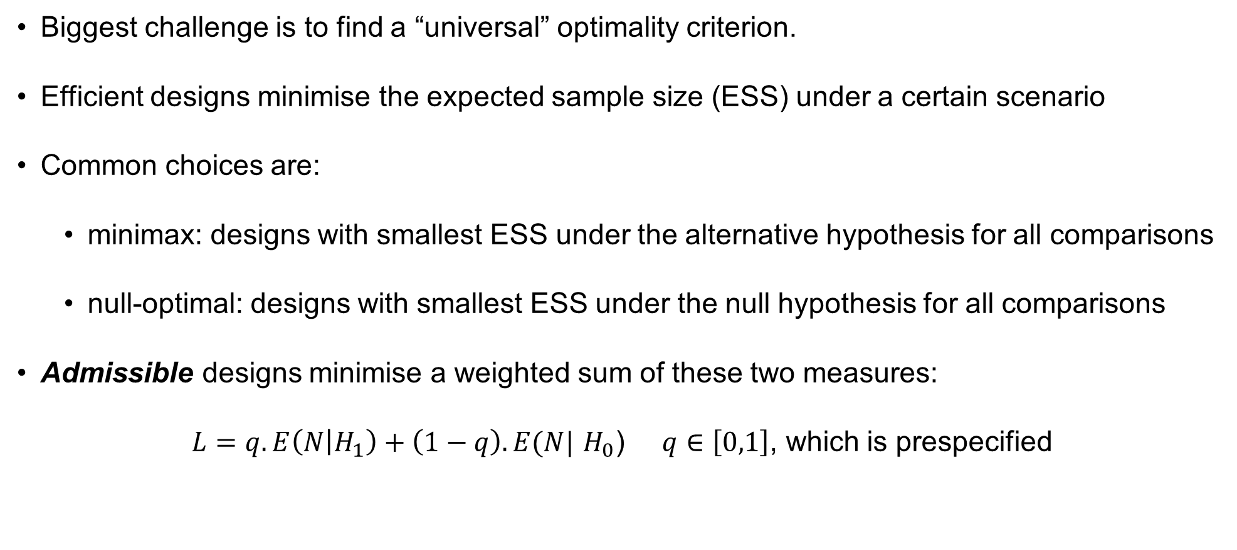
Step 1 leads us to optimal MAMS designs
Biggest challenge is to find a “universal” optimality criterion.
Efficient designs minimise the expected sample size (ESS) under a certain scenario
Common choices are:
minimax: designs with smallest ESS under the alternative hypothesis for all comparisons
null-optimal: designs with smallest ESS under the null hypothesis for all comparisons
Admissible designs minimise a weighted sum of these two measures:
$L=q. E\left(N | H_{1}\right)+\left(1−q\right).E(N|$ $H_{0}$) $q∈\left[0,1\right]$, which is prespecified
Loss function used in nstagebinopt
Notes:
Designs which minimise the expected sample size E(N) under a particular hypothesis (optimal design) are of interest

Slide 9
Back to the surgical trial

Slide 10
nstagebinopt command for admissible designs
Syntax:
nstagebinopt, alpha(0.025) power(0.85) fwer nstage(3) arms(8) theta0(0) theta1(-0.05) ctrlp(0.15) ltfu(0.04) fu(4) accrate(118 248 248) aratio(0.5) plot
Aim to control of the FWER
Remove if aim is to control
pairwise error rate (PWER)
Notes:
Program searches for optimal/admissible designs and outputs them as a table.

Slide 11
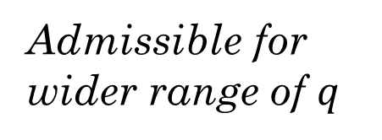
nstagebinopt output
n-stage (binary) trial design version 1.0.2, 09 June 2023
---------------------------------------------------------------------------------
Admissible designs for a 8-arm 3-stage trial with binary outcome based on
Choodari-Oskooei, Bratton, and Parmar (2023) Stata Journal 23(3).
---------------------------------------------------------------------------------
Design q-range Stage Sig. Power Alloc. E(N|H0) E(N|H1) FWER
number level ratio (SE)
---------------------------------------------------------------------------------
1 [0.00,0.09] 1 0.31 0.93 0.50 4658 8667 0.0249
2 0.16 0.93 (0.0003)
3 0.005 0.92
---------------------------------------------------------------------------------
2 [0.10,0.65] 1 0.40 0.94 0.50 4683 8437 0.0253
2 0.14 0.94 (0.0003)
3 0.005 0.91
---------------------------------------------------------------------------------
3 [0.66,0.77] 1 0.15 0.93 0.50 4989 8277 0.0254
2 0.08 0.93 (0.0003)
3 0.005 0.90
---------------------------------------------------------------------------------
4 [0.78,1.00] 1 0.27 0.99 0.50 6506 7824 0.0253
2 0.14 0.99 (0.0003)
3 0.004 0.85
---------------------------------------------------------------------------------
Note: each design minimises the loss function (1-q)E(N|H0)+qE(N|H1) for values of
q specified in q_range. H1 is the hypothesis that all of the experimental
arms are effective.
Admissible for wider range of $q$
Notes:
Program searches for optimal/admissible designs and outputs them as a table.

Slide 12
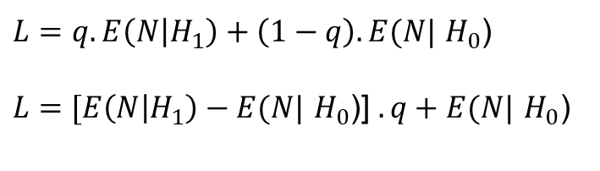
Loss function vs probability of success
$L=q. E\left(N | H_{1}\right)+\left(1−q\right).E(N|$ $H_{0}$)
$L=$ $[E\left(N | H_{1}\right)−E(N|$ $H_{0}$)] $.q+E(N| H_{0}\text{)}$

Slide 13
Loss function vs probability of success
$L=q. E\left(N | H_{1}\right)+\left(1−q\right).E(N|$ $H_{0}$)
$L=$ $[E\left(N | H_{1}\right)−E(N|$ $H_{0}$)] $.q+E(N| H_{0}\text{)}$

Slide 14
Loss function vs probability of success
$L=q. E\left(N | H_{1}\right)+\left(1−q\right).E(N|$ $H_{0}$)
$L=$ $[E\left(N | H_{1}\right)−E(N|$ $H_{0}$)] $.q+E(N| H_{0}\text{)}$

Slide 15
Loss function vs probability of success
$L=q. E\left(N | H_{1}\right)+\left(1−q\right).E(N|$ $H_{0}$)
$L=$ $[E\left(N | H_{1}\right)−E(N|$ $H_{0}$)] $.q+E(N| H_{0}\text{)}$

Slide 16
Step 2: nstagebin for sample size calculations
Syntax:
nstagebin, alpha(0.40 0.14 0.005) power(0.94 0.94 0.91) nstage(3) theta0(0) theta1(-0.05) ctrlp(0.15) arms(8 6 4) ltfu(0.04) fu(4) accrate(118 248 248) aratio(0.5) tunit(4)
Notes:
Program performs sample size calculations and produces easy-to-interpret output with sample size per stage and operating characteristics

Slide 17
Step 2: nstagebin output
Output has 2 main sections
Section 1
n-stage trial design - binary outcome version 1.0.2, 09 June 2023
-----------------------------------------------------------------------
Sample size for a 8-arm 3-stage trial with binary outcome based on
Bratton et al. (2013) BMC Med Res Meth 13:139 and Choodari-Oskooei,
Bratton, and Parmar (2023) Stata Journal 23(3).
-----------------------------------------------------------------------
Control arm event rate = 0.15
Delay in observing outcome = 4 months
Attrition rate for outcome = 0.04
Operating characteristics
-----------------------------------------------------------------------------
Alpha(1S) Power theta|H0 theta|H1 Length* Time*
-----------------------------------------------------------------------------
Stage 1 0.4000 0.940 0.000 -0.050 19.979 19.979
Stage 2 0.1400 0.940 0.000 -0.050 9.165 29.144
Stage 3 0.0050 0.910 0.000 -0.050 11.994 41.138
Pairwise 0.0040 0.850 41.138
FWER(SE)** 0.0253 (0.0003)
-----------------------------------------------------------------------------
* Length (duration of each stage) is expressed in month periods
** FWER is calculated using simulations with 250000 replications
Notes:
Program performs sample size calculations and produces easy-to-interpret output with sample size per stage and operating characteristics

Slide 18
Step 2: nstagebin output
---------Stage 1---------
Overall Control Exper.
------------------------------------------------
Number of active arms 8 1 7
Accrual rate* 118.0 26.2 91.8
Active arms
Patients for analysis 1809 402 201
Patients recruited** 2358 524 262
All arms
Patients recruited** 2358
------------------------------------------------
---------Stage 2---------
Overall Control Exper.
------------------------------------------------
Number of active arms 6 1 5
Accrual rate* 248.0 70.9 177.1
Active arms
Patients for analysis 2989 854 427
Patients recruited** 4108 1173 587
All arms
Patients recruited** 4632
------------------------------------------------
---------Stage 3---------
Overall Control Exper.
------------------------------------------------
Number of active arms 4 1 3
Accrual rate* 248.0 99.2 148.8
Active arms
Patients for analysis 4719 1887 944
Patients recruited** 4915 1966 983
All arms
Patients recruited** 6613
------------------------------------------------
Section 2
Notes:
Program performs sample size calculations and produces easy-to-interpret output with sample size per stage and operating characteristics

Slide 19
More on nstagebin & nstagebinopt
Both programs allow for the use of intermediate outcome (I) observable before definitive outcome (D) for Lack-Of-Benefit (LOB) assessment.
e.g., culture status (I-outcome) & failure/relapse in TB
They use Dunnett’s probability to account for multiplicity.
Consider the underlying correlation structure between different tests
More efficient than Bonferroni or Sidak corrections
Feasible/admissible designs found by nstagebinopt can be saved in a dataset.
For further inspection of their properties regarding trial timelines, sample sizes, etc
Computationally, they are very efficient.
2-arm 2-stage designs: both output the results in less than a second
8-arm 3-stage design: nstagebinopt (95 seconds), nstagebin (5 seconds)
Notes:
- Now we focus in on the particular class of MAMS design under consideration
- Methods for a multi-arm 2-stage design were developed in the early 2000s and later extended to the multi-stage setting
- Developed for time-to-event outcomes with applications in cancer trials
- Later extended to trials with binary outcomes
- Targets late phase/confirmatory trials – most costly phase of testing
- Makes pairwise comparisons between multiple research arms and 1 common control arm – no direct head to head comparisons of research arms
- Permits the use of an intermediate outcome measure which is correlated with definitive/primary outcome but can be observed earlier to allow trigger interim analyses early on in trial
- This int/I-outcome could be composite including primary outcome e.g. FFS/PFS an intermediate outcome for OS
- Early interim analyses allow us to drop arms mid-trial if they do not demonstrate sufficient benefit against the control arm (LOB assessment)
- Such a design is denoted $I≠D$ to indicate the intermediate outcome differs from the definitive outcome
- I=D correspondingly denotes a design in which the same outcome measure is used throughout
- Benefits
Increased probability of success
See data as it accrues
Time & resource efficient
Considerations
Multiple testing impacts operating characteristics
Correlation between test statistics (due to shared control arm and shared patients across stages)

Slide 20
Validating and testing nstagebin & nstagebinopt
The FWER and overall power:
Checked against analytical solutions where possible
Used mvnormal Stata command (Grayling and Mander)
Sample size calculations:
Compared against Cytel’s EAST software and artbin Stata command
Perfect agreement was achieved for a wide range of design types, taking into account differences in rounding
Re-ran the design do files of MAMS trials, compared the outputs/results, and checked for error messages and discrepancies.
The algorithm (and nstagebin) has been applied to design new MAMS trials in TB, maternal health, surgical wound infection, and leg ulcer.
Notes:
MAMS designs can greatly increase the rate at which new treatments are evaluated by
Incorporating phase 2 and 3 into a single trial
Assessing multiple new treatments vs a common control
Ceasing recruitment to arms which are showing no effect during the trial

Slide 21

Stata suite for MAMS designs: nstagebin & nstagebinopt

Slide 22
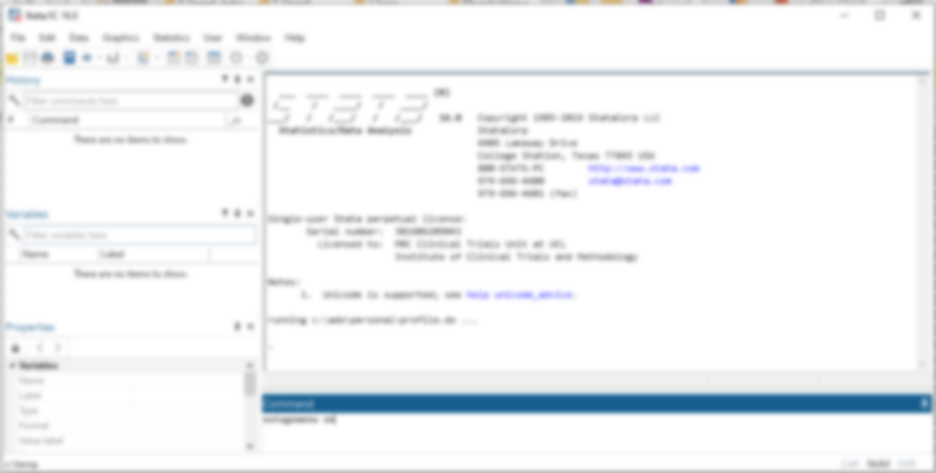
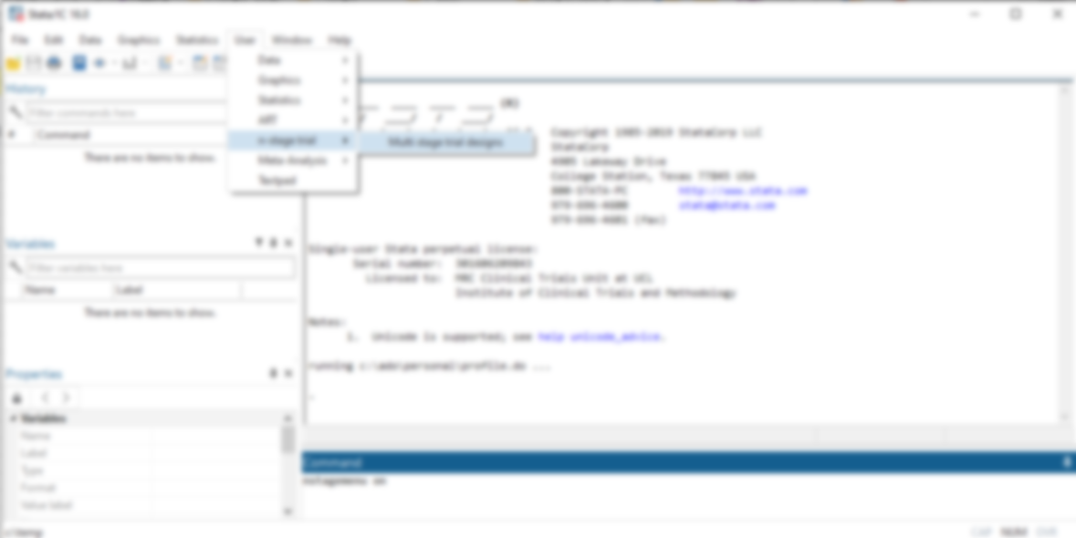
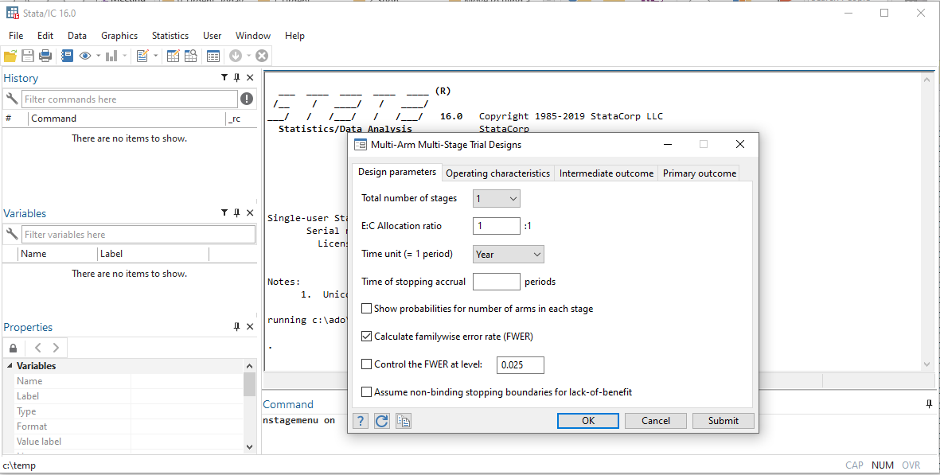
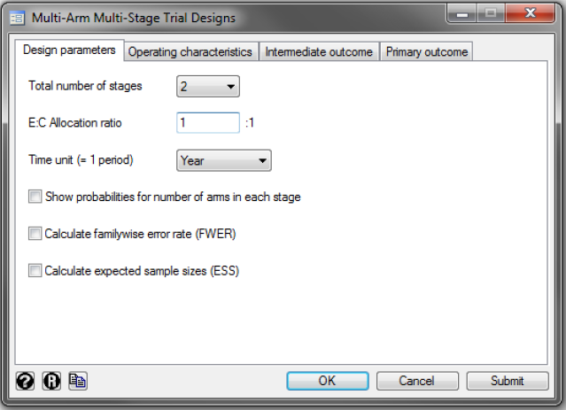
nstage Stata suite for MAMS designs: nstagebin & nstagebinopt

Slide 23
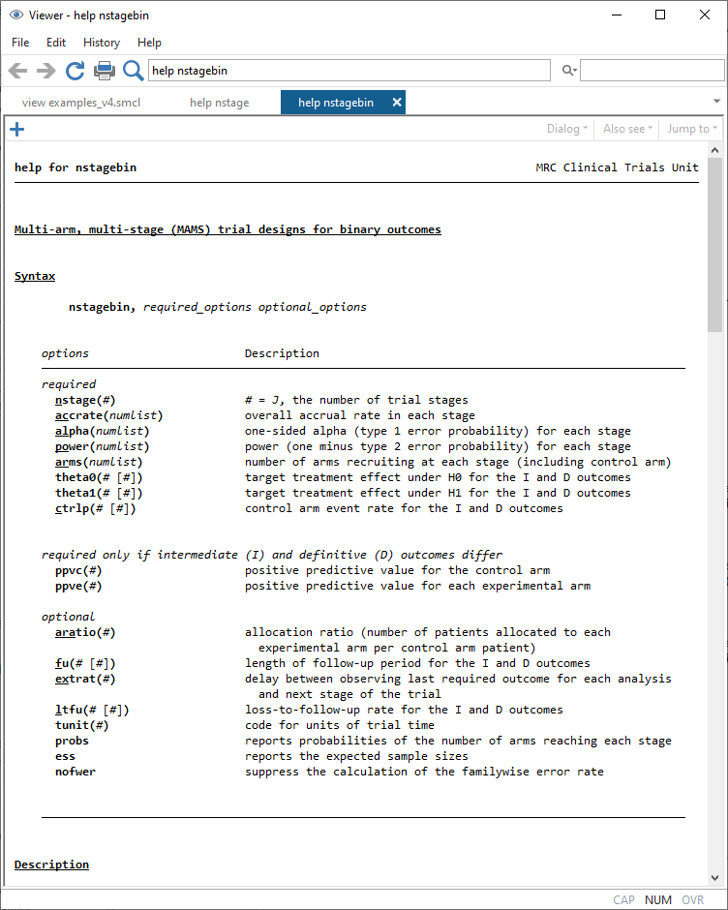
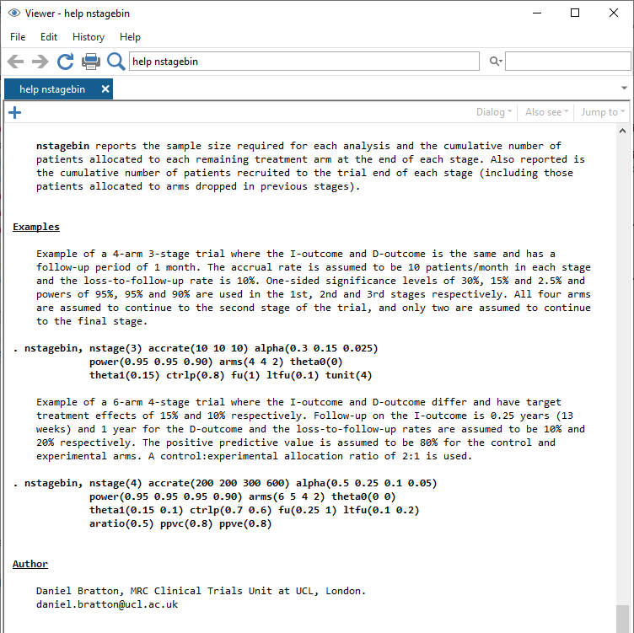
nstage Stata suite for MAMS designs: nstagebin & nstagebinopt

Slide 24
Summary
nstagebinopt and nstagebin Stata commands can be used to design efficient MAMS trials with a given accrual pattern - available from the SSC.
Use simulations (MAMS) and analytical derivations (two-arm setting) to calculate the operating characteristics.
Validated against numerous other software and published sample sizes.
The associated Stata Journal article is in-press, September 2023 edition.
Further work will allow use of any combination of outcomes (e.g. continuous I outcome, binary D outcome) and incorporating treatment selection at early stages.
Notes:
MAMS designs can greatly increase the rate at which new treatments are evaluated by
Incorporating phase 2 and 3 into a single trial
Assessing multiple new treatments vs a common control
Ceasing recruitment to arms which are showing no effect during the trial

Slide 25
Acknowledgement
We would like to thank:
Stata journal editorial team, particularly Stephen Jenkins
SJ production team
Ian White for comments on earlier version of article
Notes:
MAMS designs can greatly increase the rate at which new treatments are evaluated by
Incorporating phase 2 and 3 into a single trial
Assessing multiple new treatments vs a common control
Ceasing recruitment to arms which are showing no effect during the trial

Slide 26
References
Choodari-Oskooei, B., D. J. Bratton, et al. (2023). "Facilities for optimising and designing multi-arm multi-stage (MAMS) randomised controlled trials with binary outcomes." Stata Journal, 23(3) in press.
Bratton, D. J., P. P. J. Phillips, et al. (2013). "A multi-arm multi-stage clinical trial design for binary outcomes with application to tuberculosis." Medical Research Methodology 13:139.
Jung, S. H., T. Lee, et al. (2004). "Admissible two-stage designs for phase II cancer clinical trials." Stat Med 23(4): 561-569.
Royston, P., F. M. Barthel, et al. (2011). "Designs for clinical trials with time-to-event outcomes based on stopping guidelines for lack of benefit." Trials 12: 81.
Royston, P., M. K. Parmar, et al. (2003). "Novel designs for multi-arm clinical trials with survival outcomes with an application in ovarian cancer." Stat Med 22(14): 2239-2256.

Slide 27
Thank you for your attention

